Slide 1


Hii,
Iam Siddhika
Welcome to Power BI Series
Part -78

Slide 2





I’m very excited to dive into this with you all!
Are you ready to enhance your data visualization skills?
We focus only on the most used and important Visuals
Today Content
VISUALIZING DATA
CUSTOM VISUALS IN POWER BI WHAT ARE CUSTOM VISUALS WHEN TO USE
EXAMPLES HOW TO ADD

Slide 3


WHAT ARE CUSTOM VISUALS
check next slide ..
Custom visuals are additional visualization types created
by developers outside of the standard Power BI visualizations.
They offer more flexibility and functionality, allowing you to tailor your reports to meet specific business needs.
Key Features :
Flexibility: Custom visuals provide unique ways to display data, which might not be available in the standard Power BI visuals.
Interactivity: Many custom visuals come with advanced interactive features, enhancing the user experience.
Customization: You can modify the appearance and behavior of custom visuals to better align with your data storytelling needs.

Slide 4

When to Use Custom Visuals:
Specific Business Needs: When standard visuals don't meet your requirements.
Enhanced User Experience: To add more interactive and engaging elements to your reports.
Unique Visualizations: To represent data in a unique way that adds value to your analysis.
got it..

Slide 5


EXAMPLES OF CUSTOM VISUALS
Bullet Chart: Compare performance against a target using a simple, linear visual.
Word Cloud: Useful for showing the most common words in text data.
Gantt Chart: Ideal for project timelines and management.
Infographic Designer: Create visually engaging charts and graphics that combine data visualization with images and icons.
we will see
how to import
custom
visuals..
Sunburst
circular
Chart:
layout,
Visualize hierarchical data in a
showing the relationship between
different levels. etc...

Slide 6
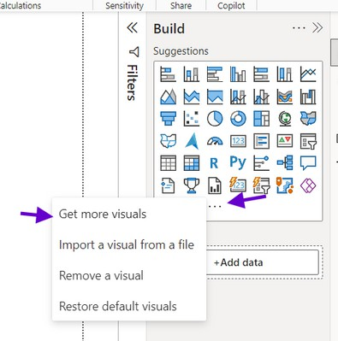
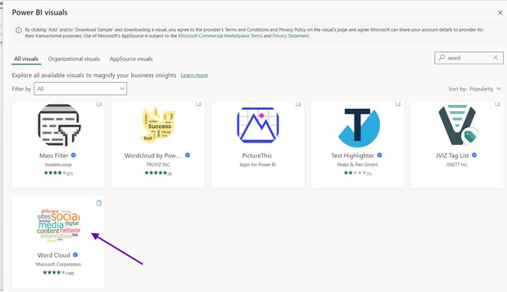
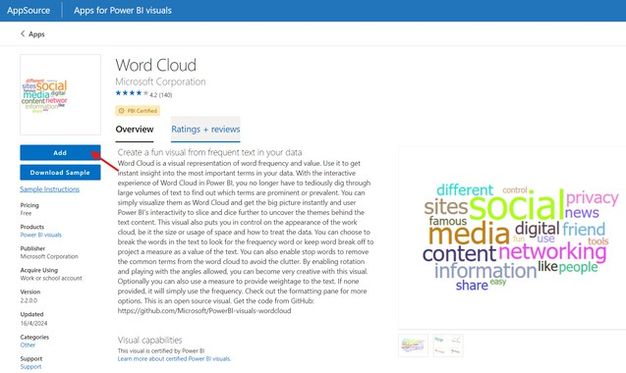

HOW TO ADD CUSTOM VISUALS
DO along with me guys with this .
From AppSource:
Go to the "Visualizations" pane. Click on the three dots (...).
Select "Get more visuals."
Find and add the visual you need.

Slide 7

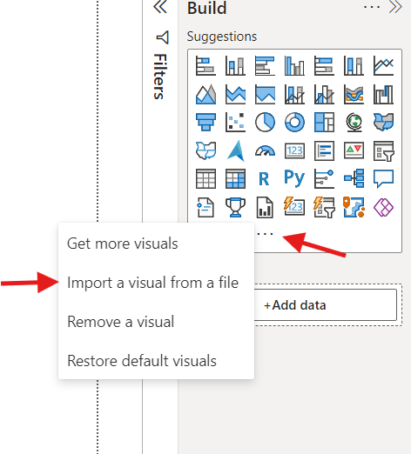
From a File:
Click on the three dots in the "Visualizations" pane.
Select "Import a visual from a file." Choose the visual file from your computer
we will see
few custom
visuals in
next parts ..

Slide 8


Thank you for joining me today to learn about Part -78 of Power BI!
Remember, Effective data visualization is crucial for turning data into meaningful insights and compelling narratives with Power BI.
Stay tuned for more insights and tips on Power BI in our next Series.
Follow

